Slide 1
Logistic Regression

Slide 2
Introduction
Logistic regression is a classification algorithm used to assign observations to a discrete set of classes.
Some of the examples of classification problems are Email spam or not spam, Online transactions Fraud or not Fraud, Tumor Malignant or Benign.
Logistic regression computes a weighted sum of input features (plus a bias term), instead of outputting result directly like the Linear Regression , it outputs the logistic of this result.
It transforms its output using the logistic sigmoid function to return a number between 0 an 1

Slide 3
Introduction Cont..
No assumptions about the distributions of the predictor variables.
Predictors do not have to be normally distributed
Logistic regression does not make any assumptions of normality, linearity, and homogeneity of variance for the independent variables.
Because it does not impose these requirements, it is preferred to
discriminant analysis when the data does not satisfy these assumptions

Slide 4
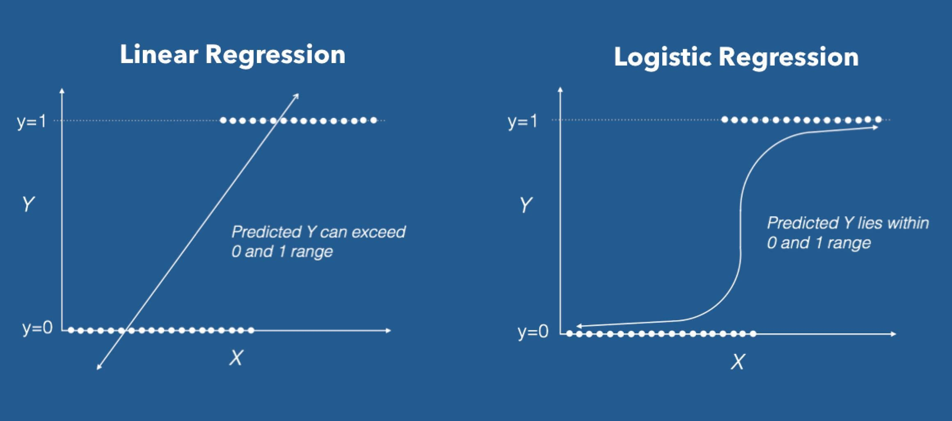
Definition – Logistic Regression
Logistic Regression (also called Logit Regression) is commonly used to estimate the probability that an instance belongs to a particular class. If estimated probability is greater than 50% then the model predicts that instance belongs to positive class or else it belongs to negative class.

Slide 5

Hypothesis – Logistic function
We can call a Logistic Regression a Linear Regression model but the Logistic Regression uses a more complex cost function, this cost function can be defined as the ‘Sigmoid function’ or also known as the ‘logistic function’ instead of a linear function.
The hypothesis of logistic regression tends it to limit the cost function between 0 and 1. Therefore linear functions fail to represent it as it can have a value greater than 1 or less than 0 which is not possible as per the hypothesis of logistic regression.

Slide 6
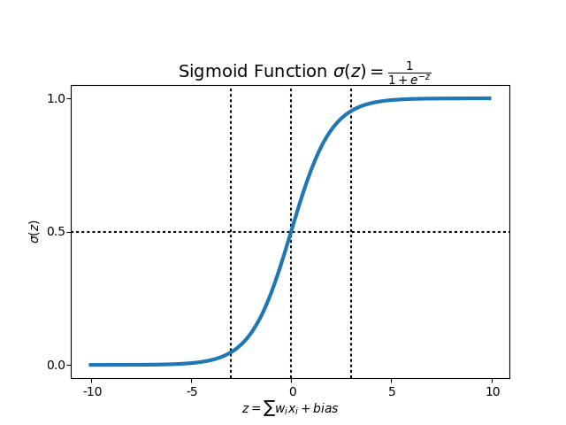
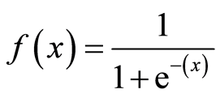
Sigmoid Function
In order to map predicted values to probabilities, we use the Sigmoid function. The function maps any real value into another value between 0 and 1. In machine learning, we use sigmoid to map predictions to probabilities.

Slide 7


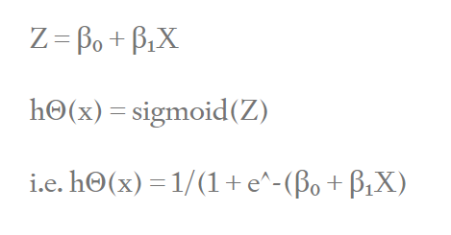
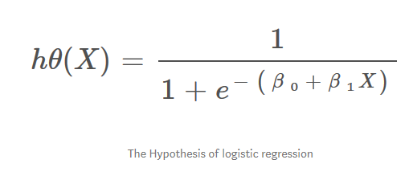
When using linear regression we used a formula of the hypothesis i.e.
For logistic regression we are going to modify it a little bit i.e.
We have expected that our hypothesis will give values between 0 and 1.

Slide 8
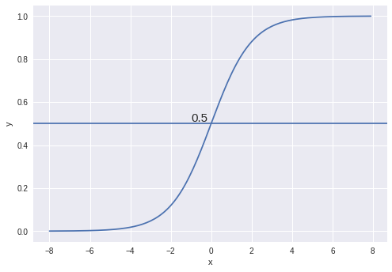
Decision Boundary
We expect our classifier to give us a set of outputs or classes based on probability when we pass the inputs through a prediction function and returns a probability score between 0 and 1.
For Example, We have 2 classes, let’s take them like cats and dogs(1 — dog , 0 — cats). We basically decide with a threshold value above which we classify values into Class 1 and of the value goes below the threshold then we classify it in Class 2.
As shown in the above graph we have chosen the threshold as 0.5, if the prediction function returned a value of 0.7 then we would classify this observation as Class 1(DOG). If our prediction returned a value of 0.2 then we would classify the observation as Class 2(CAT).

Slide 9
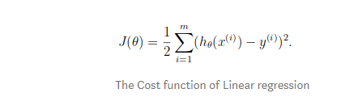
We learnt about the cost function J(Ɵ) in the Linear Regression, the cost function represents optimization objective i.e. we create a cost function and minimize it so that we can develop an accurate model with minimum error.
If we try to use the cost function of the linear regression in ‘Logistic Regression’ then it would be of no use as it would end up being a non-convex function with many local minimums, in which it would be very difficult to minimize the cost value and find the global minimum.

Slide 10
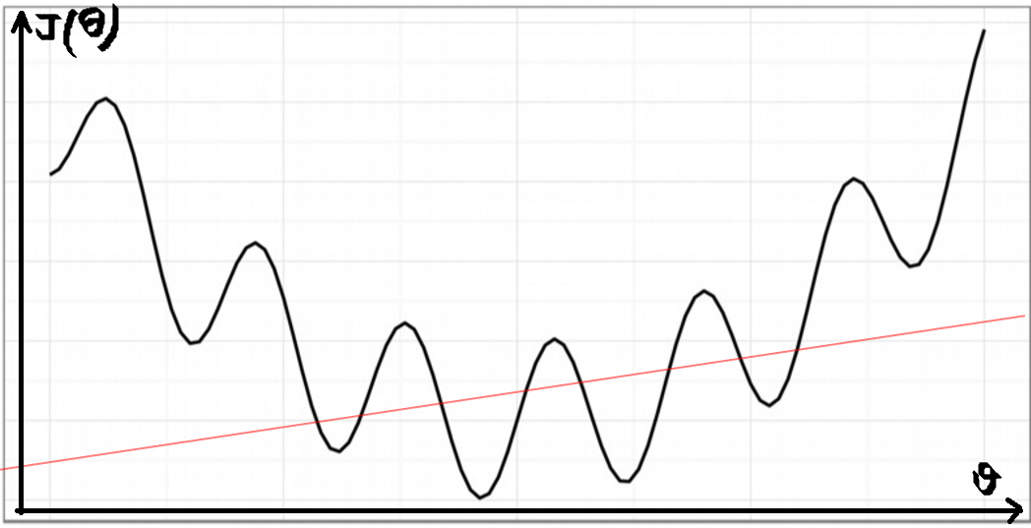
Non-convex Function

Slide 11
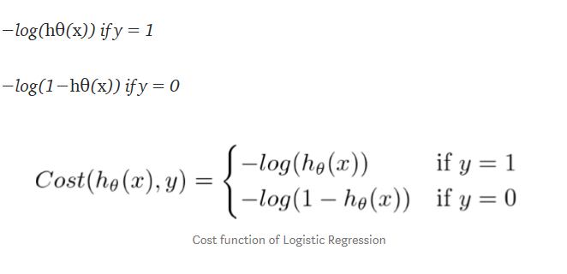
For logistic regression, the Cost function is defined as:

Slide 12
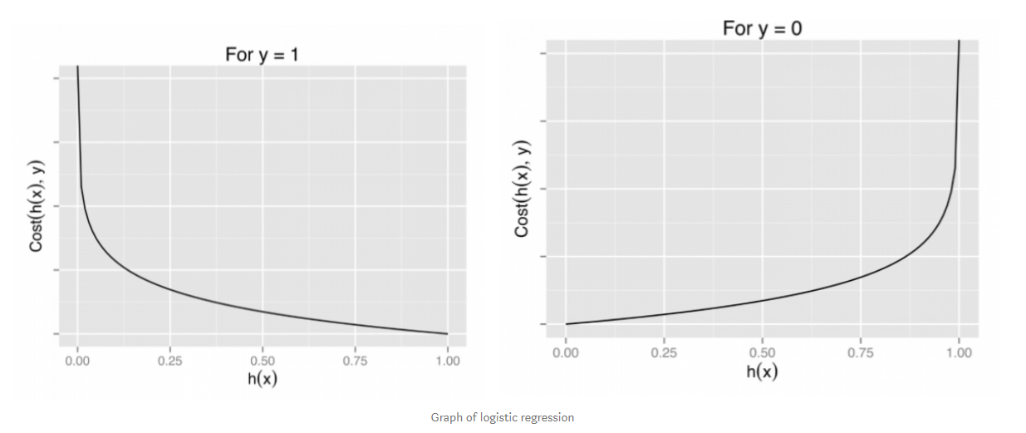
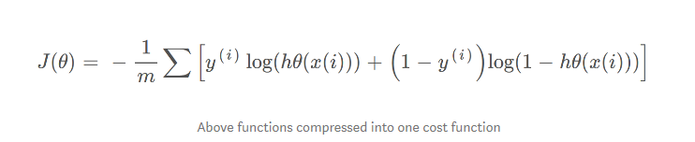
The above two functions can be compressed into a single function i.e.

Slide 13
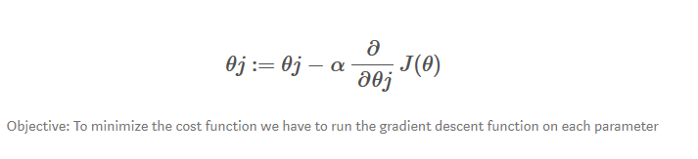
Gradient Descent
Now the question arises, how do we reduce the cost value. Well, this can be done by using Gradient Descent. The main goal of Gradient descent is to minimize the cost value. i.e. min J(Ɵ).
Now to minimize our cost function we need to run the gradient descent function on each parameter i.e.

Slide 14
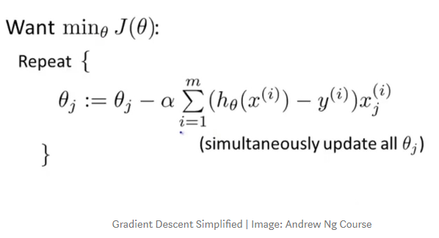
Gradient descent has an analogy in which we have to imagine ourselves at the top of a mountain valley and left stranded and blindfolded, our objective is to reach the bottom of the hill. Feeling the slope of the terrain around you is what everyone would do. Well, this action is analogous to calculating the gradient descent, and taking a step is analogous to one iteration of the update to the parameters.

Slide 15
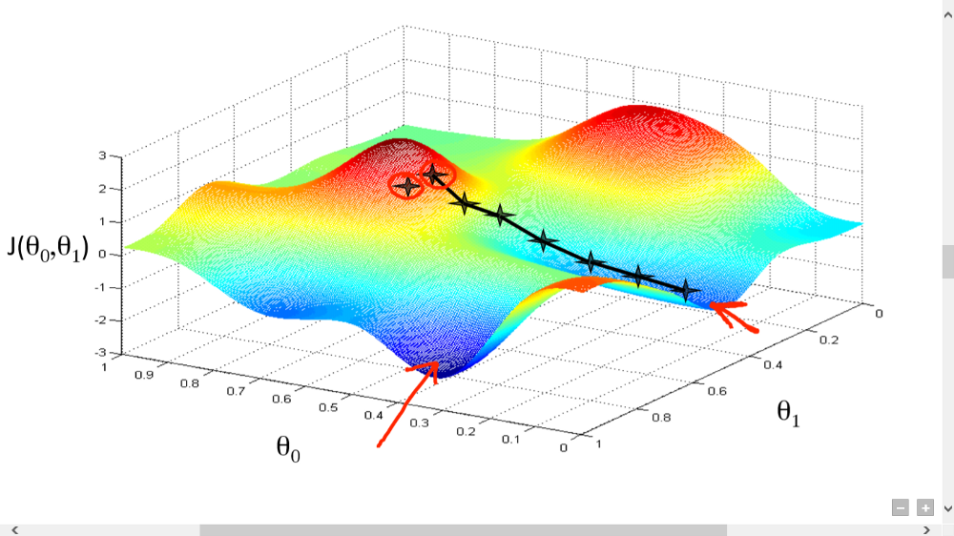
Gradient Descent Analogy

